Slide 1
ICT Initiatives at India with emphasis on DIKSHA
Central Institute of Educational Technology(CIET)
National Council of Educational Research and Training (NCERT)
(An Autonomous organisation set up by
Ministry of Education, Government of India)

Slide 2
Imparting equitable quality education
and lifelong learning is the goal
CPD of
10 million Teachers
is a challenge
Skill training of youth
(two third population)
1.3 bn. People
1.5 million Schools
900+ universities
17000+ TEIs
330 million students
Bridging the
Digital Divide
is the goal
Education
Scenario
in India

Slide 3
https://www.mentimeter.com/app/presentation/alq119ygydsx12snkdw59bc415edrwkm/dr95xkrqbuwo/edit

Slide 4
Issues & Challenges of Implementing Technology in Education
Quality digital resources
Diversity
Infrastructure
2
4
6
1
3
5
Large Scale
Technology Competencies
Convergence in efforts

Slide 5
ICT Use in India: Policy Directions
EDUSAT,
ICT @ School CAL NME - ICT
Revised ICT @ School & ICT Award
ET Scheme
INSAT
Class Project
NPE
NPE-POA
1972
1983
1984
1986
1992
2004
2010
2020-23
2019
2018
2017
2015
2013
2012
NEP - 2020, NETF
PRAGYATA Guidelines, PM-eVidya & NDEAR,
VSK, NCF-FS
NISHTHA, Guidelines for Development of eContent
Samagra Shiksha, Cyber Safety & Security Guidelines
SWAYAM MOOCs, SWAYAM Prabha- DTH Channels & DIKSHA
Digital India, ePathshala & ePG - Pathshala
NROER & ICT Curriculum
ICT Policy

Slide 6
NEP 2020 - Thrust of Technological Interventions
Teaching- learning & evaluation processes
Supporting teacher preparation & professional development
Enhancing educational access
Streamlining educational management and administration
Removing language barriers
Access to Divyang students

Slide 7
NEP-2020: Recommendations for Online and Digital Education
Digital Infrastructure
Building Digital competencies of Students
Portals, Apps and Tools
Content-Pedagogy-Technology Integration, Use of Assistive Technologies
Digital Resources
Educational Technology & ICT
Capacity building of Teachers,Teacher Educators
Telecast and Broadcast
Laying down Standards
eGovernance
Online Assessment and Examination
Intensive Research in ET

Slide 8
Digital Initiatives
https://www.menti.com/alyh4yo72n2q

Slide 9
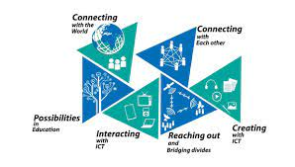
Major Digital Initiatives
PMeVIDYA
ePathshala
1
2
DIKSHA
3
NISHTHA
SWAYAM
6
ICT
Curriculum
4
5

Slide 10
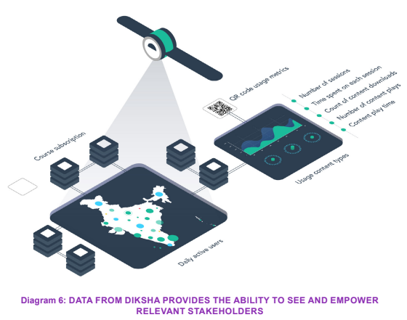
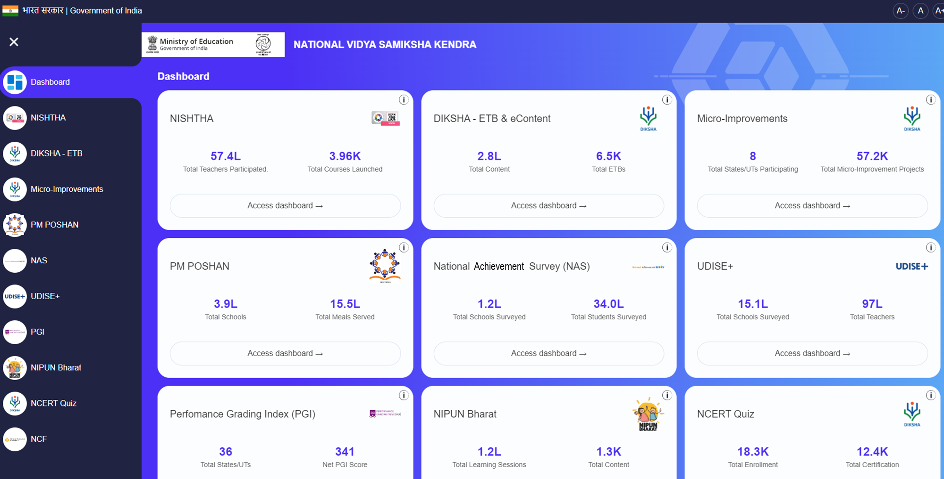
Vidya Samiksha Kendra (VSK)
Vidya Samiksha Kendra : helping us see & monitor policy implementation and drive reforms
Visibility: ‘Ability to See’ in real time
Actionability: ‘Ability to Amplify Actions’ through coordinated efforts
Insights: ‘Ability to Make Sense’ of data
https://diksha.gov.in/

Slide 11
Continuous Professional Development (CPD)
Around 65 lakh+ Teachers, Teacher Educators & School Heads
NISHTHA
1
2
6,44,360 Certificates issued
CPD Courses
4,17,338 enrolled including students, teachers, parents and civil service aspirants
MOOCs for School Education
3
Platforms: MOODLE, SUNBIRD, OPEN edX, Google Course Builder
Online Capacity Building on ET/ ICT
7Lakh + Certificates issued
4

Slide 12
NISHTHA
NISHTHA
for NIPUN Bharat
NISHTHA (ECCE) (Ongoing)
NISHTHA
(Elementary Level)
NISHTHA
(Secondary Level)
18 Courses | 12 Courses | 10 Courses | 06 Courses
30 States/ UTs and 7 autonomous organisations under MoE and MoD | 33 States/UTs and 8 autonomous organization under MoE, MoD and MoTA | 33 States/UTs and 5 autonomous organizations under MoE | 29 States/ UTs initiated POs, CDPOs, Supervisors, DIET faculty from DRU for NFE & AE
11 language - Assam, Bengali, Bodo, English, Kannada, Hindi, Telugu, Odia, Gujarati, Punjabi, Urdu | 10 language - Hindi, English, Urdu, Gujarati, Punjabi, Telugu, Kannada, Bengali, Marathi and Odia | 11 language - Hindi, English, Urdu, Gujarati, Punjabi, Telugu, Kannada, Odia ,Bengali, Marathi and Mizo | 2 languages - Hindi , English
42 Lakh
7.2 Lakh
12.9 Lakh
Target -34,000
https://nishtha.nic.in/

Slide 13
Virtual Labs
https://diksha.gov.in/virtuallabs.html
200+ Virtual Labs
https://diksha.gov.in/play/collection/do_3135898447443312641324?contentId=do_31358831977352396812487

Slide 14
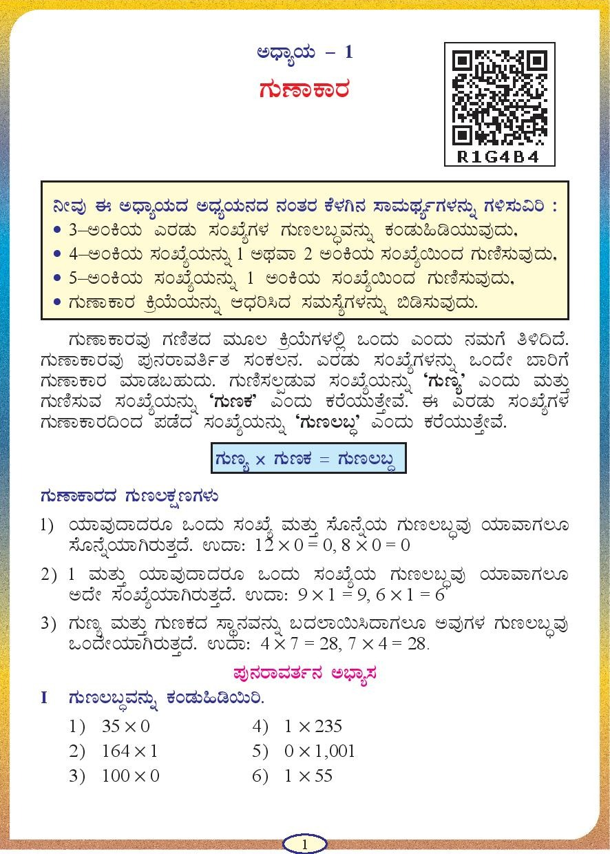
Phygital
Bridging of physical and digital worlds by ‘energizing’ textbooks...
...which lead to ease of access to relevant digital content across the nation and enable continuity of learning
QR Code linking to relevant e-content (student and teacher facing content)
State board, Grade 5th Textbook
NCERT, Grade 8th textbook
e-Textbooks
Explanation Resources
Practice Resources
Learning Resources
Teacher Focused Resources

Slide 15
Augmented Reality (AR)
https://play.google.com/store/apps/details?id=com.ncert.ARApps&hl=en_IN&gl=US&pli=1

Slide 16
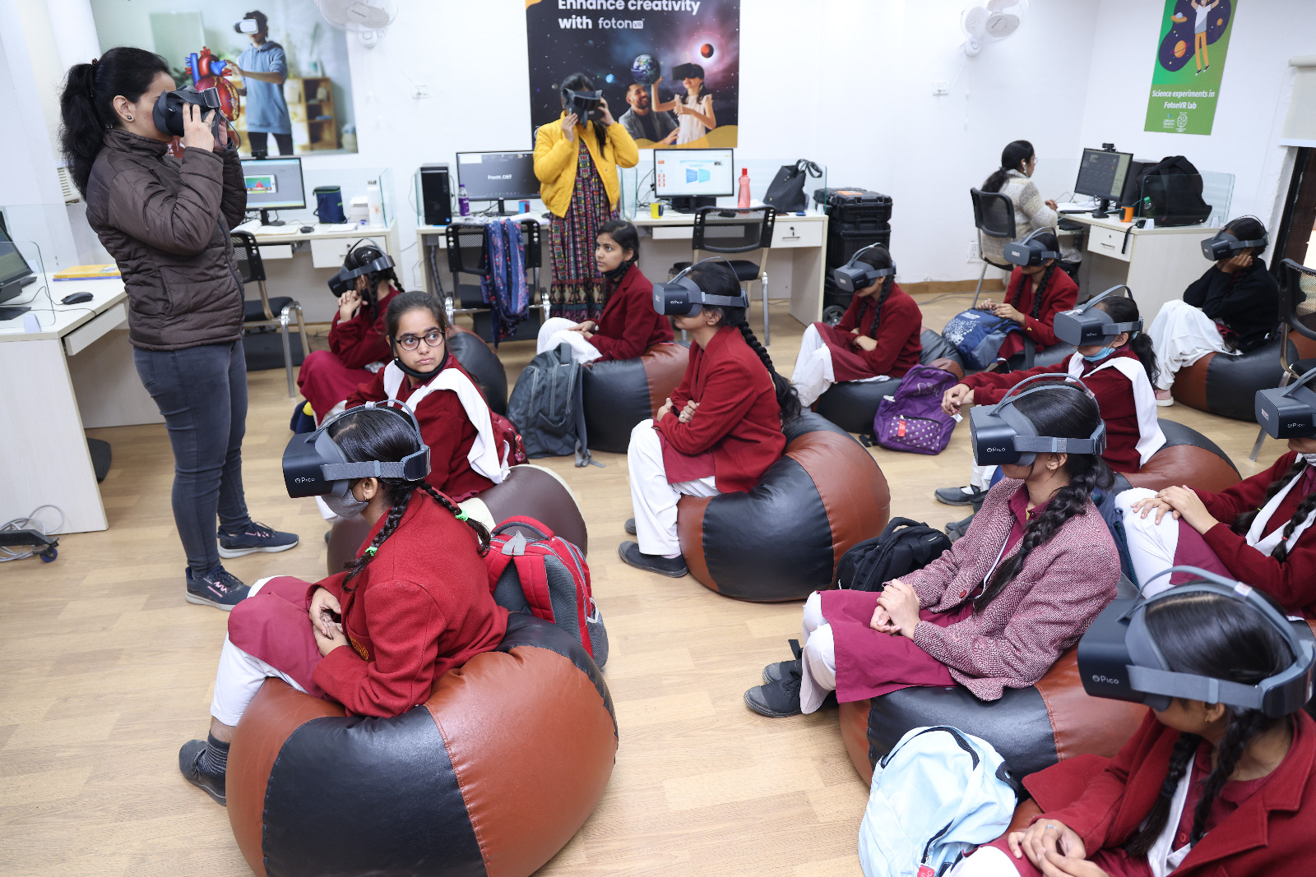
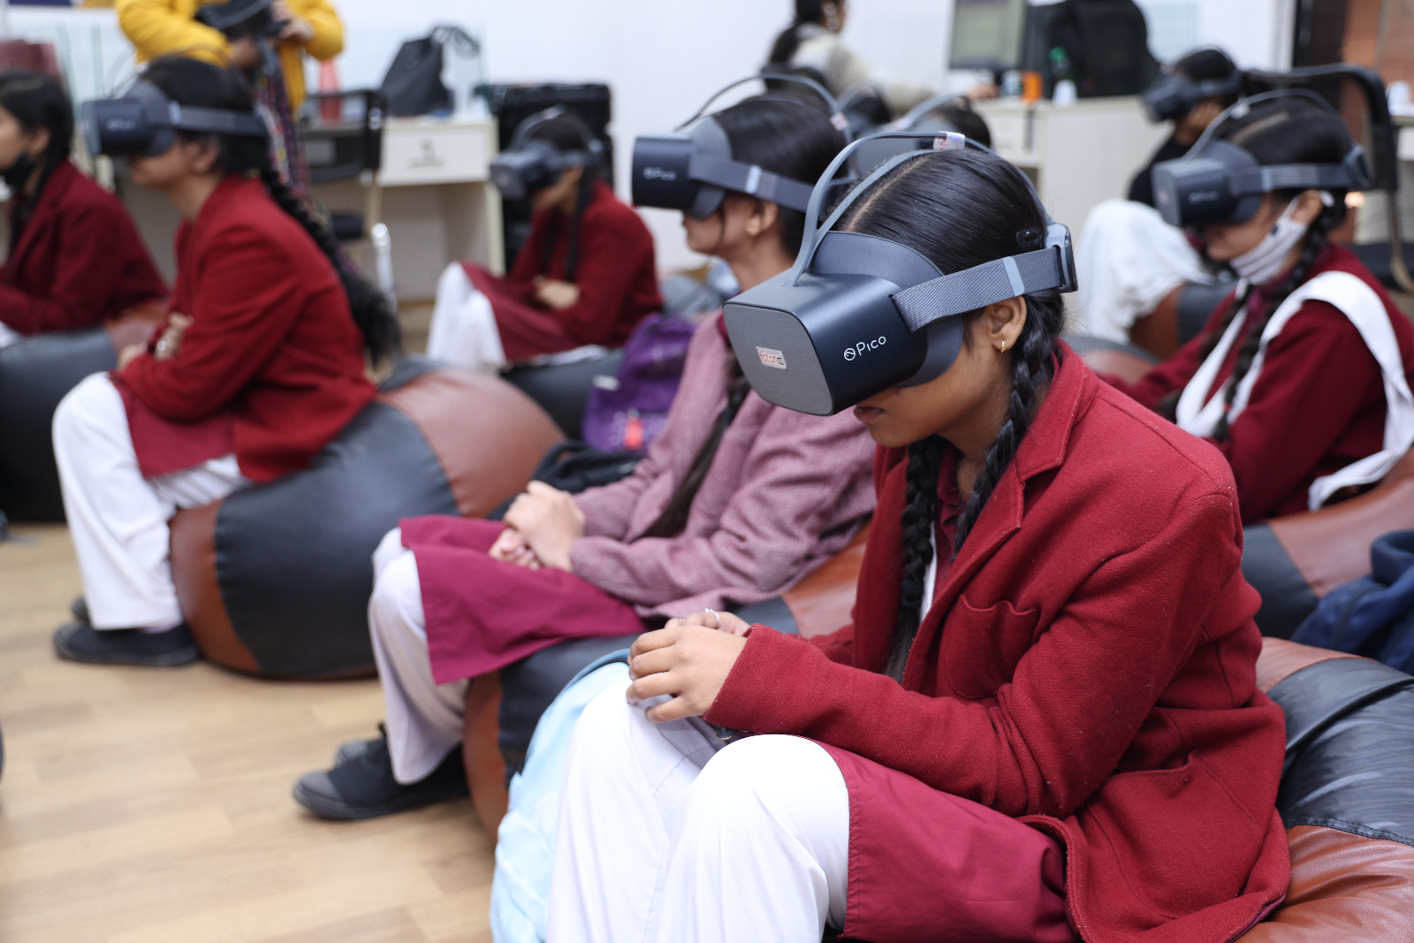
Experiential Lab

Slide 17
DIKSHA
Repository of Open Educational Resources
Collaborative Platform
Curriculum-aligned content
Analytics
Multilingual support
Offline access
Foundational Literacy and Numeracy (FLN)
Adult Education
Virtual Lab
Children with special needs (CWSN)
Vocational Education
Jaadui Pitara
https://diksha.gov.in/

Slide 18
DIKSHA
6,697+ ETBs by States / UTs
3,41,666+ eContent
13,563 + eCourses
13.5 million page hits on daily basis
Supports 38 languages Including 22 scheduled languages and indian sign languages (ISL).
https://diksha.gov.in/

Slide 19
DIKSHA’s building blocks were used for multiple use cases
DIKSHA
Energised Textbooks
Teacher Professional Development
Question Bank
Digital Credentials
Collaboration
Phygital
DIKSHA
DIKSHA
Content Sourcing
Content Authoring
Quizzes
cQube
Surveys
Language Translations
Content Consumption
Data Tools & Dashboards
Vidya Samiksha Kendra - CCC
System to monitor, mentor, manage the whole ecosystem
Chatbot
Mentoring
Sunbird Registry and Credentials

Slide 20
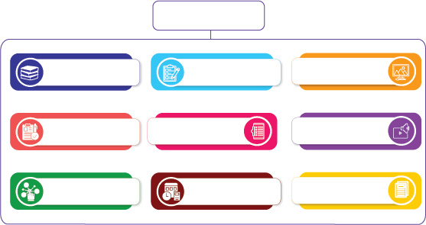
CIET - NCERT develops…
variety of digital contents
Energized books
Assessment questions
Infographics
Guidelines/ Handbooks
Videos, UDL videos
eCourses
Interactive & Immersive content
Audios, Talking Books, Audio Books
Worksheets

Slide 21
eContents ….
eContent in curricular and generic areas various Indian Languages
Age appropriate content for various stakeholders - Students, Teachers, Teacher Educators, Parents etc
Universal Design of Learning (UDL) based content
Collaboration and Partnership

Slide 22
Game Based Learning
http://itfdigitalgames.ncert.org.in/

Slide 23
eContents based on UDL

Slide 24
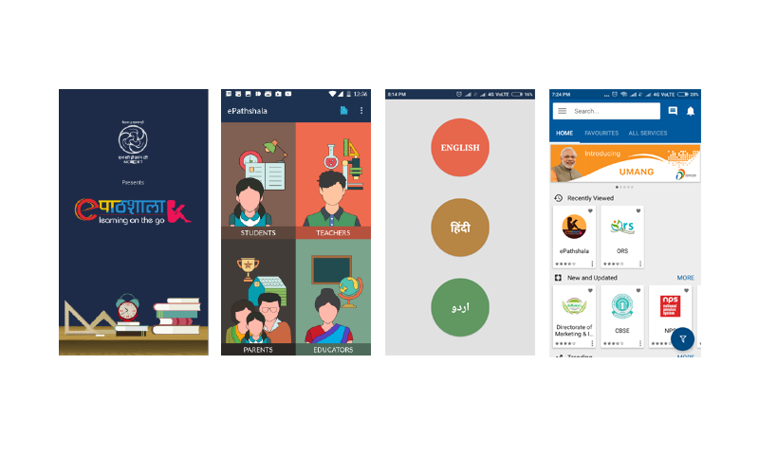
ePathshala
# 20,18,62,568 visitors on Portal
# 30 M users in UMANG
App Rating
4.3 on Google play store
3.5 on Apple Store
App downloads/Users
55,47,565 on Google
21,61,272 on Apple
# Total Books as ePub: 2,344
# Total no of Flipbook: 2,757
https://https://epathshala.nic.in/

Slide 25
Dissemination through Educational Apps

Slide 26
PRASHAST
https://play.google.com/store/apps/details?id=com.dscs.app&hl=en_IN&gl=US&pli=1
https://ncert.nic.in/pdf/DSCS_booklet.pdf

Slide 27
PM e-VIDYA
PM e-VIDYA focuses on unification of efforts, enabling multi-mode access to education
PM e-Vidya focuses on developing multi channel learning continuum
Television
Radio
DIKSHA
Special
e-Content
Online Courses
One Class, One TV Channel
Radio Broadcast / Podcast/
Community Radio
One Nation, One Platform
E-content for specially abled DIVYANG (CWSN)
Online Courses for School Education
DIKSHA, Television and Radio are the focus of discussion for resilient and coherent access
https://www.swayamprabha.gov.in/

Slide 28
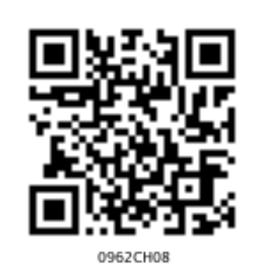
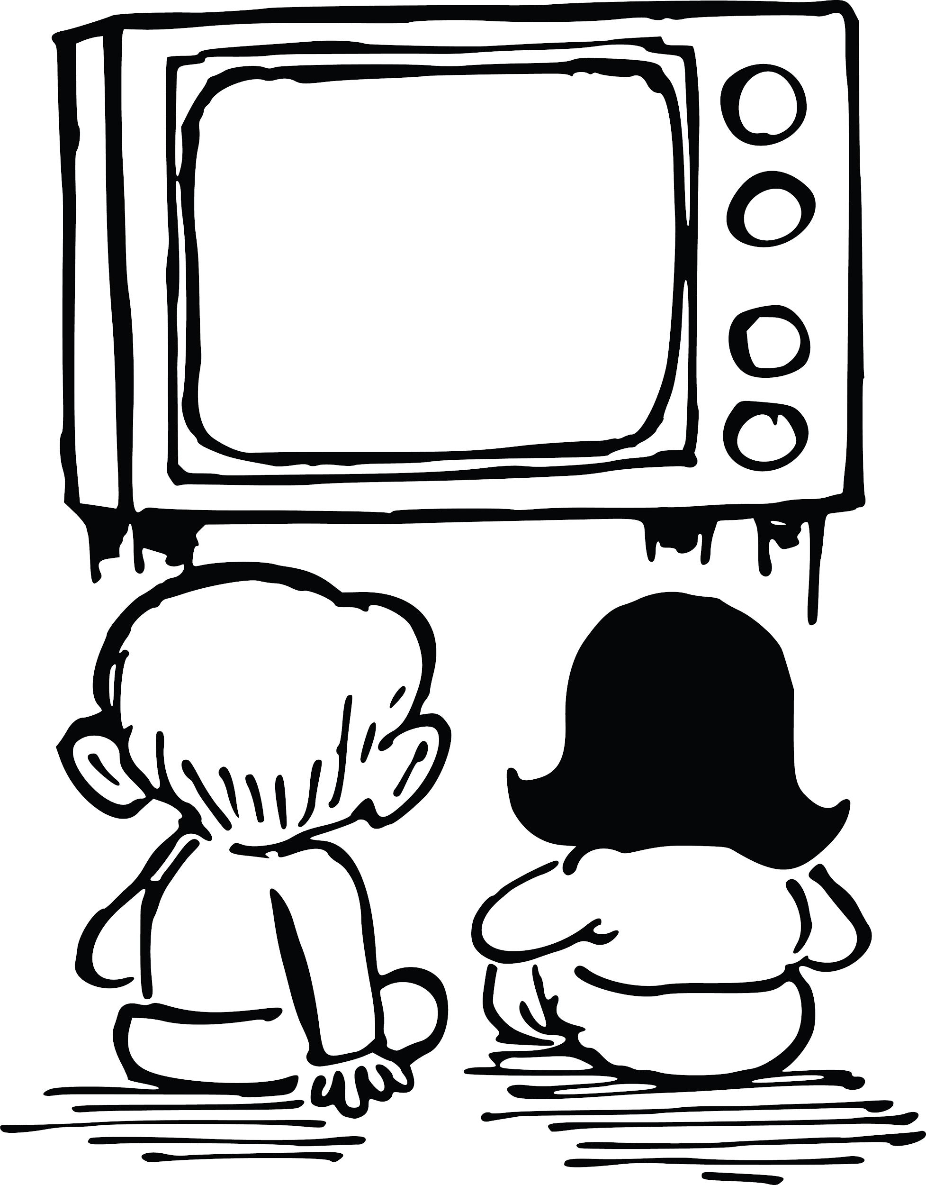
NCERT has leveraged DIKSHA to enable Coherent Access
e-Textbooks
Explanation Resources
Don’t worry! Just scan the QR code on screen using DIKSHA app on your phone
- TV session
I have missed the first half of this session, what should I do?
Practice Resources
Learning Resources
Teacher Focused Resources
0962CH08
On phone
Phone
On PC
Easy access of content for Chapter wise across grades and subjects through DIKSHA, TV, Radio

Slide 29
Present status of PM eVIDYA 12 DTH TV Channels
6,822 video programmes
4,247 ISL Programmes
Both in English and Hindi medium for classes 1-12
ISL video lessons telecast
6,415 Live Show
13,667 Content Reviewed
Covering 3435.5 hours based on AAC
NCERT, NIOS, NVS, RILM, States/UTs
3,994 pieces of curriculum-based radio programmes broadcasted on 398 Radio Stations & 2,557 live sessions on iRadio and JioSaavn Mobile apps

Slide 30
Television
12 DTH TV Channels on 24×7 basis daily and simulcast on Jio TV App, Private cable operators, YouTube channel etc.
11069 curriculum based videos developed for school education in English, Hindi including Indian Sign Languages (ISL) including vocational education
One hour live session for each class for clarification of doubts
IVRS support for addressing queries of students

Slide 31
Radio
4,300 pieces of curriculum-based radio programmes (Classes 1 -12)
Broadcast on 400 Radio Stations (11 GyanVani FM Radio Stations, 257 Community Radio Stations, 132 All India Radio stations), iRadio and JioSaavn Mobile apps
3,997 live programs podcast on iRadio

Slide 32
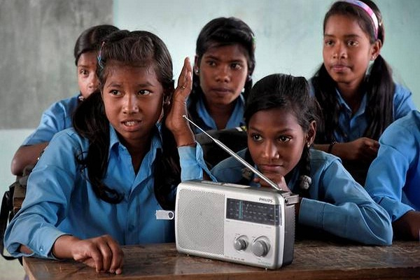
Radio
400
3,997
4,300
Curriculum based radio program(Class 1-12)
Radio Stations
LIVE radio podcasts

Slide 33
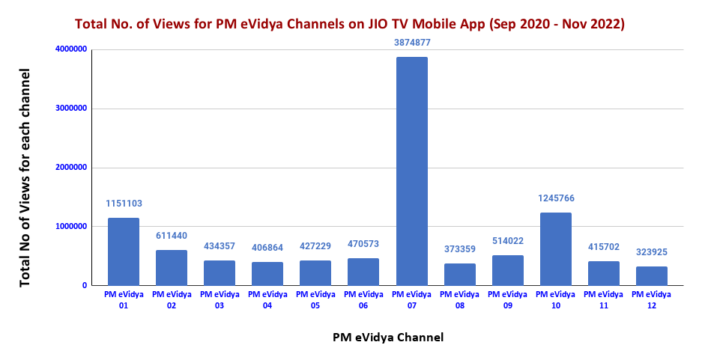
Viewership details
PM eVIDYA Channel
Viewership of PM eVIDYA 12 DTH channels on JIo TV mobile app 1,02,49,217
Total No of Views for each channel

Slide 34
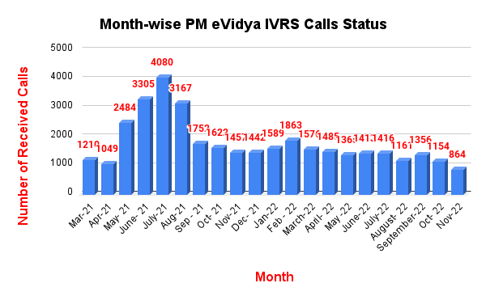
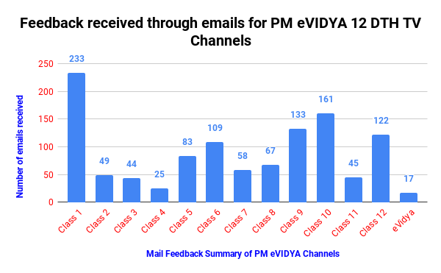
Feedback Mechanism
IVRS, Email & WhatsApp Group
Email: 1,259 Emails received
Radio Broadcast
PM eVIDYA IVRS no. (8800440559)- 59,754 calls received
TV Telecast
Manodarpan IVRS no. (8448440632)- 28,159 calls received

Slide 35
Standards & Guidelines for Digital Education

Slide 36
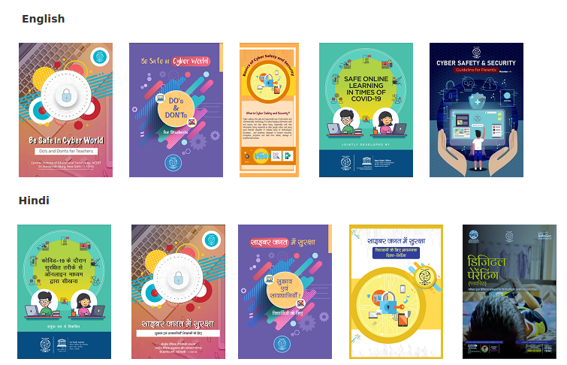
Cyber Safety Guidelines
https://ciet.nic.in/pages.php?id=booklet-on-cyber-safetysecurity&ln=en&ln=en

Slide 37
International Collaboration
Trained master trainers of Mauritius on developing and disseminating OER, Developed a portal and mobile app
School Online Programme - Collaboration between Indian and Israel Schools
Trained master trainers of Nepal on developing and disseminating eContents and OER
School Online Programme - Collaboration between Indian and Korean Schools
Shared eContents developed by NCERT

Slide 38
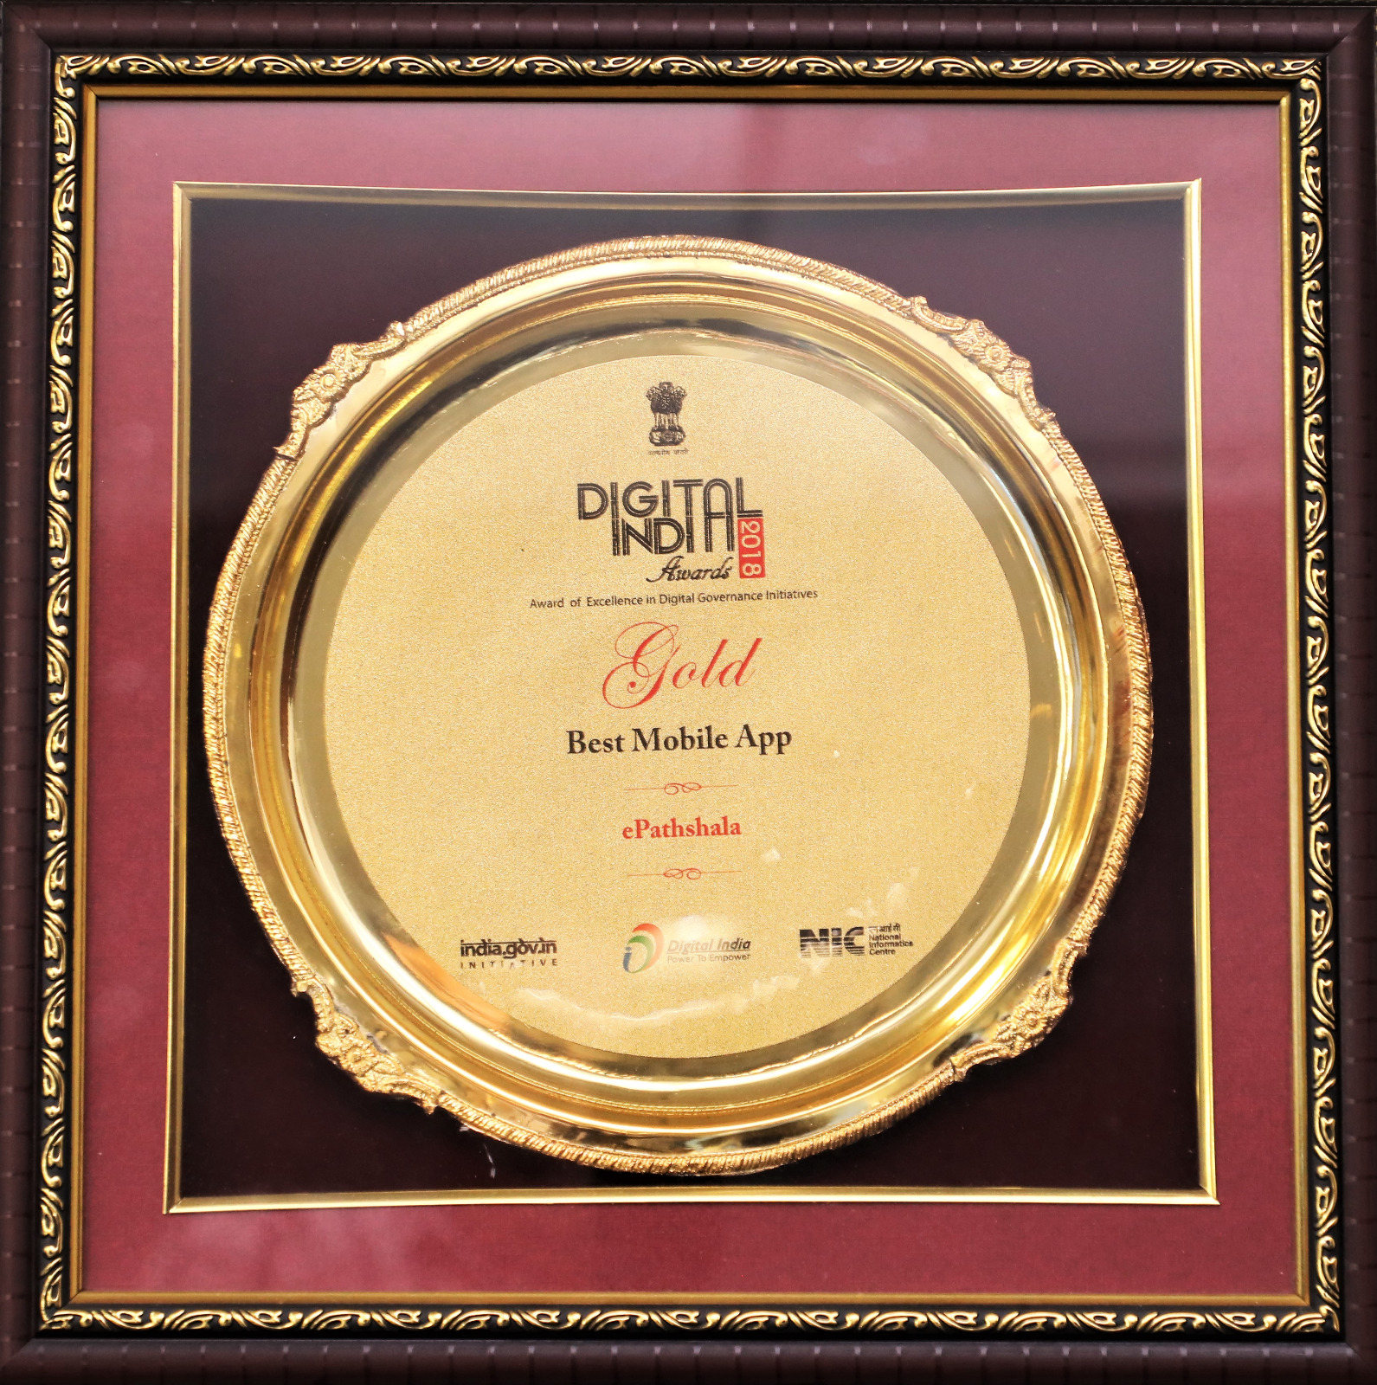
Appreciations

Slide 39
https://create.kahoot.it/share/digital-initiatives-at-national-level-in-the-context-of-nep-2020-lessons-for-secondary-schools/f719b85c-e076-4a89-886c-03fdde936538

Slide 40
Thank You
indu.kumar@ciet.nic.in

